Slide 1
Lesson objective
Title: Topic review
Aim:
Be able to apply index laws
Evaluate index notation
Plan:
Review laws
Skills practice
Evaluating

Slide 2
If index numbers with the same base are multiplied then powers are added.
If index numbers with the same base are divided then powers are subtracted.
If a base number is raised to the power zero,
then the result is one.
If an index number is raised to another power
then the powers are multiplied.
Notes:
Student guided notes

Slide 3
If index numbers with the same base are multiplied then powers are added.
If index numbers with the same base are divided then powers are subtracted.
If a base number is raised to the power zero,
then the result is one.
If an index number is raised to another power
then the powers are multiplied.

Slide 4
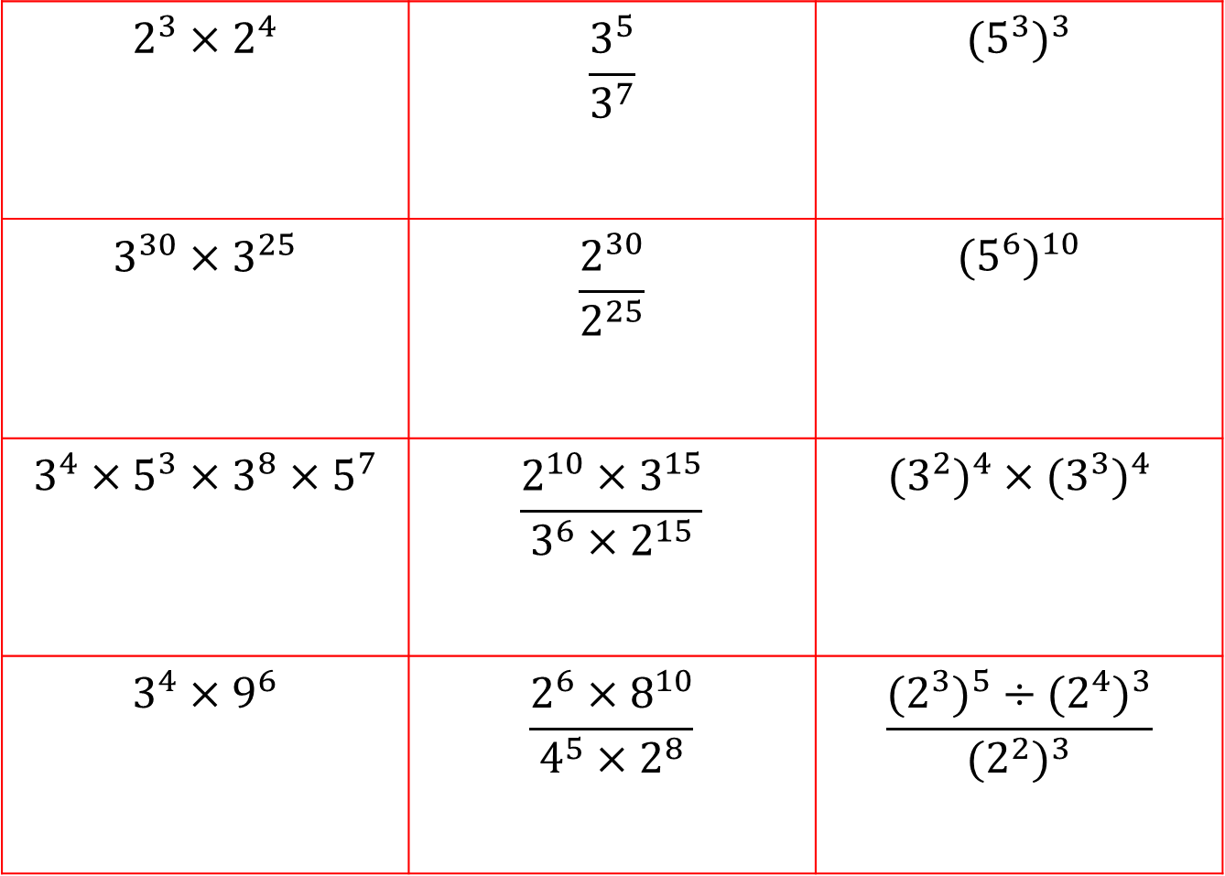
Year 8 Indices revision worksheets
$$2^{3}×2^{4}$$ | $$\frac{3^{5}}{3^{7}}$$ | $${(5^{3})}^{3}$$
$$3^{30}×3^{25}$$ | $$\frac{2^{30}}{2^{25}}$$ | $${(5^{6})}^{10}$$
$$3^{4}×5^{3}×3^{8}×5^{7}$$ | $$\frac{2^{10}×3^{15}}{3^{6}×2^{15}}$$ | $${{(3}^{2})}^{4}×({3^{3})}^{4}$$
$$3^{4}×9^{6}$$ | $$\frac{2^{6}×8^{10}}{4^{5}×2^{8}}$$ | $$\frac{{{(2}^{3})}^{5}÷{{(2}^{4})}^{3}}{{{(2}^{2})}^{3}}$$
Notes:
Student worksheet

Slide 5
Year 8 Indices revision worksheets
$$2^{3}×2^{4}$$ | $$\frac{3^{5}}{3^{7}}$$ | $${(5^{3})}^{3}$$
$$3^{30}×3^{25}$$ | $$\frac{2^{30}}{2^{25}}$$ | $${(5^{6})}^{10}$$
$$3^{4}×5^{3}×3^{8}×5^{7}$$ | $$\frac{2^{10}×3^{15}}{3^{6}×2^{15}}$$ | $${{(3}^{2})}^{4}×({3^{3})}^{4}$$
$$3^{4}×9^{6}$$ | $$\frac{2^{6}×8^{10}}{4^{5}×2^{8}}$$ | $$\frac{{{(2}^{3})}^{5}÷{{(2}^{4})}^{3}}{{{(2}^{2})}^{3}}$$

Slide 6
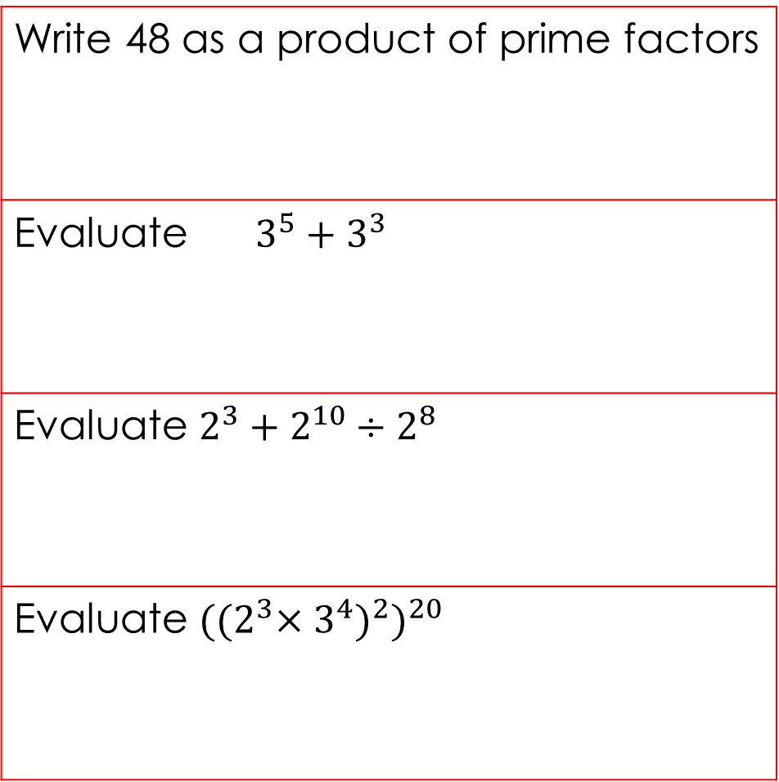
Year 8 Indices revision worksheets
Write 48 as a product of prime factors
Evaluate $3^{5}+3^{3}$
Evaluate $2^{3}+2^{10}÷2^{8}$
Evaluate ${{{((2}^{3}×3^{4})}^{2})}^{20}$
Notes:
Student worksheet

Slide 7
Year 8 Indices revision worksheets
Write 48 as a product of prime factors
Evaluate $3^{5}+3^{3}$
Evaluate $2^{3}+2^{10}÷2^{8}$
Evaluate ${{{((2}^{3}×3^{4})}^{2})}^{20}$

Slide 8

Evaluating
Means solve or provide an answer for.
E.g., evaluate 2 + 7 =
Evaluate (I do):
$2^{4} ÷ 2^{2}=$
$2^{3}+ 2^{2}=$
$2^{2} × 2^{2}=$
$6^{3} ÷ 6^{5}=$

Slide 9

Evaluate: exercise books
${ 2}^{2}+ 2^{2}=$
${ 5}^{2} −10=$
${ 4}^{2} − 2^{2}=$
${ 5}^{6} ÷ 5^{9}=$

Slide 10
Notes page
Index laws
Examples
Worded statements (from our guided notes today)

